Slide 1
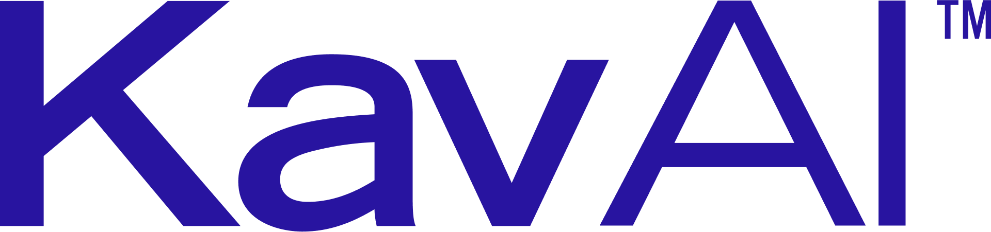

PROMO / APRIL 2026
KAV AI PLATFORM · KAP V3.2
Active Physical Intelligence ™ for asset integrity.
The first platform to close the loop between what sensors see, what process data says, and what engineering codes require — delivering risk decisions in hours, not weeks.
REAL-TIME INTEGRITY INTELLIGENCE SYSTEM
INVESTIGATE & ESCALATE
KAVAI.COM

Slide 2
Kav AI Platform
01 / THE PROBLEM
THE INTEGRITY GAP
Integrity data exists. Decisions don't.
Inspection, SCADA and engineering records live in separate silos. The people responsible for facility safety spend days manually reconciling them — while damage mechanisms keep running.
<10%
5–10d
$2M
of captured inspection imagery is reviewed by a qualified engineer under current workflows.
to move from inspection capture to actionable integrity decision across mid-sized facilities.
a day — the cost of an unplanned shutdown at a mid-sized refinery, at the top of the range.
SOURCE: KAV AI CUSTOMER DISCOVERY · SOLOMON ASSOCIATES, 2023
02 / 17

Slide 3
Kav AI Platform
02 / THE PLATFORM
WHAT KAV AI IS
The integrity intelligence layer above existing systems.
WHAT KAV AI IS NOT
—
Not a hardware manufacturer.
—
Not a SCADA replacement.
KAP ingests visual inspection data, reads operational data from SCADA and process historians, and reasons across both in a persistent 3D model of the facility — continuously updating risk and recommending action.
—
Not a general-purpose industrial AI platform.
→
Read-only. Never writes to SCADA or control systems.
BEACHHEAD: REFINERY & PETROCHEMICAL · EXPANDING TO LNG, POWER, CHEMICALS
03 / 17

Slide 4
Kav AI Platform
03 / HOW IT WORKS
OBSERVE · REASON · RECOMMEND
See, reason, recommend — in one system.
01
02
03
SEE
REASON
RECOMMEND
Multi-modal capture, normalised into a single photorealistic 3D model.
Multimodal AI correlates visual, thermal and process data against the integrity domain model.
Decisions surface in minutes via a natural-language interface — every action engineer-confirmed.
— RGB · Thermal · OGI
— Drone & confined-space fleets
— Autonomous robot patrols (KRSI)
— Fixed sensors & SCADA (read-only)
— P&ID, line-list, materials (CAD)
— API 584 IOW classification
— API 571 damage mechanisms
— API 581 risk scoring + P90 life
— Stage 3.5 consistency gate
— Out-of-distribution detector
— Prioritised inspection plans
— CMMS work order packets
— Chat over the 3D model
— HITL sign-off required
— Full audit trail, timestamped
RECOMMENDATIONS ONLY. READ-ONLY ON THE CONTROL NETWORK.
04 / 17

Slide 5
Kav AI Platform
04 / THE INTEGRITY CHAIN
INTEGRITY ANALYTICAL CHAIN
IOW → DMR → risk → inspection plan, continuously.
1
2
3
3.5
4
5–6
NORMALISE
IOW CHECK
DMR
CROSS-CHECK
VALIDATE
ACT
Multi-source data QC'd with ±500 ms timestamp alignment.
SCADA scored against API 584 limits by duration × intensity.
API 571 damage mechanism mapping, enriched with CAD context.
Campaign, patrol and SCADA evidence reconciled at the consistency gate.
Physical validation against UT, thermal, OGI and robot-sourced NDT.
API 581 risk + P90 life → prioritised inspection plan & CMMS work order.
Result Triage-to-work-order cycle reduced from 5–10 days to under 4 hours.
CRITICAL FINDINGS REQUIRE ENGINEER CONFIRM / DISMISS / RECLASSIFY BEFORE CMMS.
05 / 17

Slide 6
Kav AI Platform
05 / THE MOAT
COMPETITIVE POSITION
Four layers. One system. No one else has all four.
LAYER
RBI INCUMBENTS ORKSOFT · MERIDIUM
DATA FUSION COGNITE · HEXAGON
AUTONOMOUS CAPTURE PERCEPTO · FLYABILITY
KAV AI
Visual inspection (multi-modal)
—
partial
✓
✓
Photorealistic 3D (from drone imagery)
—
needs LiDAR / CAD
—
✓ 3DGS
SCADA/IOW context (API 584)
✓
✓
—
✓
Damage mechanism reasoning (API 571)
✓
—
—
✓
Deployment time
6–18 mo
6–18 mo
weeks
90-day pilot
HARDWARE-AGNOSTIC AT EVERY LAYER. NO VENDOR LOCK-IN.
06 / 17

Slide 7
Kav AI Platform
06 / WHY NOW
TIMING
Four technologies crossed the line in 2024.
KAP was not possible at scale three years ago. It is now.
01
02
03
04
3D GAUSSIAN SPLATTING
MULTIMODAL AI REASONING
VENDOR-NEUTRAL OPC UA
PLUG-AND-PLAY AI TOOLS
Navigable, photo-quality facility models built from standard drone imagery — at 1/100 the cost of LiDAR.
Large models crossed the threshold for correlating visual, thermal and sensor data in a single analysis.
Read-only SCADA access across Emerson, Siemens, AVEVA, Ignition — without vendor lock-in.
New integration standards let AI call specialised detection models as tools — no custom pipeline work.
ENABLING TECHNOLOGIES REACHED PRODUCTION READINESS BETWEEN 2023 AND 2024.
07 / 17

Slide 8
Kav AI Platform
07 / THE VALUE CASE
THE VALUE CASE
What a mid-size refinery unlocks.
Recurring savings fund adoption. Avoided major events create the asymmetric upside.
HARD SAVINGS
OPERATIONAL VALUE
RISK AVOIDED
$3–8M/yr
$5–20M/yr
$50–150M+
Inspection optimisation, LDAR labor efficiency, turnaround scope control.
Downtime reduction, faster root-cause analysis, faster decisions.
Per major event avoided — business interruption, repairs, insurance impact.
PAYBACK TARGET
12–18 months, validated through a 90-day site pilot.
Solomon Associates 2023
DIRECTIONAL PLANNING RANGES; VALIDATED WITH BASELINE DATA DURING PILOT.
08 / 17

Slide 9
Kav AI Platform
08 / INDUSTRY BASELINE
OI.EXPERT × KAV AI
Six cost categories. Real evidence per claim.
Mid-size refinery, 200–250 kBPD, North America. Each row carries an evidence tier — confirmed, derived, or estimate.
01 · ROUTINE INSPECTION
02 · MAJOR TURNAROUND
ESTIMATE
03 · UNPLANNED DOWNTIME
ESTIMATE
DERIVED
$150–250M/TA
$5–8M/yr
Every 6–8 yrs. McKinsey: poor pre-TA inspection drives 15–25% overruns and 5–15 extra days offline.
$3–15M/yr
NDE, corrosion monitoring, DMR, IOW, RBI upkeep. Solomon RAM: facilities >2% PRV are over-spending.
US DOE: 92% of mechanical shutdowns are unplanned. McKinsey: LOC events drove ~75% margin spike.
→ KAP target: $1–2M/yr
→ KAP target: $1–5M/yr annualised
→ KAP target: $3–15M/yr
04 · INSURANCE PREMIUM
DERIVED
05 · LDAR & EMISSIONS
DERIVED
06 · RCA LATENCY
CONFIRMED
$5–15M/yr
$1–15M+/event
$1.2–3M/day
Repeat LOC / PSE incidents drive material premium escalation. CSB orders impose multi-year obligations.
EPA / TCEQ fines plus remediation per major flaring or LOC event. Carbon penalties rising under US/CA frameworks.
Valero St. Charles: every day of TA overrun. McKinsey: RCA without continuous history takes 5–10 days longer.
→ KAP audit trail + SOC 2 supports renewal
→ KAP target: $0.5–1M/yr LDAR saving
→ KAP target: $2–10M/yr
SOURCES: AOC RBMI · VALERO · SOLOMON RAM 2023 · US DOE · MCKINSEY 2024 · BCG 2025
09 / 17

Slide 10
Kav AI Platform
09 / SAVINGS MODEL
SAVINGS MODEL
$5–15M/yr recurring. $20M+ with performance.
For each pain point: what KAP delivers, the reduction, and the evidence underwriting it.
COST CATEGORY
INDUSTRY BASELINE
KAP SAVING
REDUCTION
EVIDENCE
Routine inspection optimisation
$5–8M/yr
$1–2M/yr
20–25%
CONFIRMED
Turnaround scope & overrun
$150–250M/TA
$1–5M/yr
5–10% annualised
DERIVED
Unplanned downtime prevention
$3–15M/yr
$3–15M/yr
Significant
DERIVED
LDAR optimisation (OGI stack)
$0.5–1M+/yr
$0.5–1M/yr
Material
DERIVED
Insurance premium reduction
$5–15M/yr
Directional
At renewal
ESTIMATE
Environmental fines avoidance
$1–15M+/event
Fewer Tier-1
30%+ fewer
DERIVED
RCA & decision latency
$1.2–3M/day
$2–10M/yr
5–10 days
CONFIRMED
TOTAL ANNUAL VALUE TARGET
INVESTMENT / PAYBACK
$5–15M recurring · up to $20M+ with performance
~$1.5M · 12–18 months
FIGURES INDICATIVE — REPLACED BY SITE MEASUREMENTS DURING 90-DAY PILOT.
10 / 17

Slide 11
Kav AI Platform
10 / VALUE TRAJECTORY
YEAR 0–5 INVESTOR TRAJECTORY
Value compounds as the facility model deepens.
Each campaign ingested → facility model improves → savings compound. Year 1 anchored on confirmed AOC + LDAR; Year 5 illustrative.
$40M
$12–32M
$13–36M
$10–28M
$30M
$7–18M
$4.5–13M
$20M
−$1.5M
$10M
$0
Y0
Y1
Y2
Y3
Y4
Y5
Pilot
Establish
Deepen
Optimise
Compound
Steady state
YEAR 5 CUMULATIVE
PAYBACK
CONFIRMED ANCHOR
$45M – $126M
12–18 months
AOC RBMI · $6.37M/yr · $63M / 10 yrs
EACH CAMPAIGN COMPOUNDS DETECTION — SITE DATA REPLACES RANGES FROM YEAR 2.
11 / 17

Slide 12
Kav AI Platform
11 / THE 90-DAY PILOT
90-DAY PROOF-OF-CONCEPT
Proof before commitment.
Not a demonstration. It runs against the client's real inspection data, real facility, real operational questions.
WEEKS 1–2
WEEKS 3–4
WEEKS 5–8
WEEKS 9–10
WEEKS 11–12
Onboarding
Baseline
Active use
Validation
Evaluation
Data ingestion, 3D model generation, OPC UA connector, OOD calibration.
Initial detections cross-validated against known historical defects.
NL queries on real integrity questions. IOW/DMR chain activated.
Findings cross-validated. False positive/negative rates measured.
Structured debrief. Calibration curve delivered. Proceed / extend / conclude.
→
Pilot fee credited toward Year 1 subscription on proceed.
→
All facility data remains client-owned.
→
Exit rights with 5 business days' notice.
SUCCESS CRITERIA AGREED IN WRITING BEFORE DATA INGESTION BEGINS.
12 / 17

Slide 13
Kav AI Platform
12 / WHAT "SUCCESS" MEANS
PILOT SUCCESS CRITERIA
Success, measured in writing.
ID
CRITERION
THRESHOLD
MEASUREMENT
SC-1
Anomaly detection recall
≥ 80%
Cross-validation against existing inspection records.
SC-2
False positive rate
≤ 20%
Pilot lead review of all flagged items.
SC-3
Query response quality
≥ 70% useful
Structured query log at Weeks 6 and 12.
SC-4
Time to first finding
< 48 hours
From completed data ingestion.
SC-5
AI response latency (P95)
≤ 5 seconds
Automated latency logging.
SC-6
SCADA correlation
≥ 1 confirmed
IOW exceedance ↔ visual anomaly at same asset.
CLIENTS MAY SUBSTITUTE OR ADD CRITERIA BY AGREEMENT.
13 / 17

Slide 14
Kav AI Platform
13 / TRACTION
FROM ZERO TO LIVE IN UNDER A YEAR
M0 → M3, shipped on real data.
● COMPLETE
● COMPLETE
● COMPLETE
● IN PROGRESS
M0
M1
M2
M3
Jul 2025
Dec 2025
Mar 2026
Jun 2026
Platform foundation
AI foundation
App MVP
AI Q2 delivery
3D viewer, auth, image gallery, operator dashboard — validated on first real inspection dataset (RGB).
Multimodal AI pipeline, NL interface, machine vision engine — tested on thermal + gas sensor data.
Production-ready 3D viewer + AI chat unified in a single operator interface. Live alpha.
Contextual data chat, sensor-native analysis, chat-with-3D-map, interactive overlays, automated reports.
Third inspection campaign planned at an oil refinery — OGI imagery, calibrated thermal, expanded gas suite, first repeat-patrol comparison.
VALIDATED AGAINST REAL INSPECTION DATA — NOT SYNTHETIC BENCHMARKS.
14 / 17

Slide 15
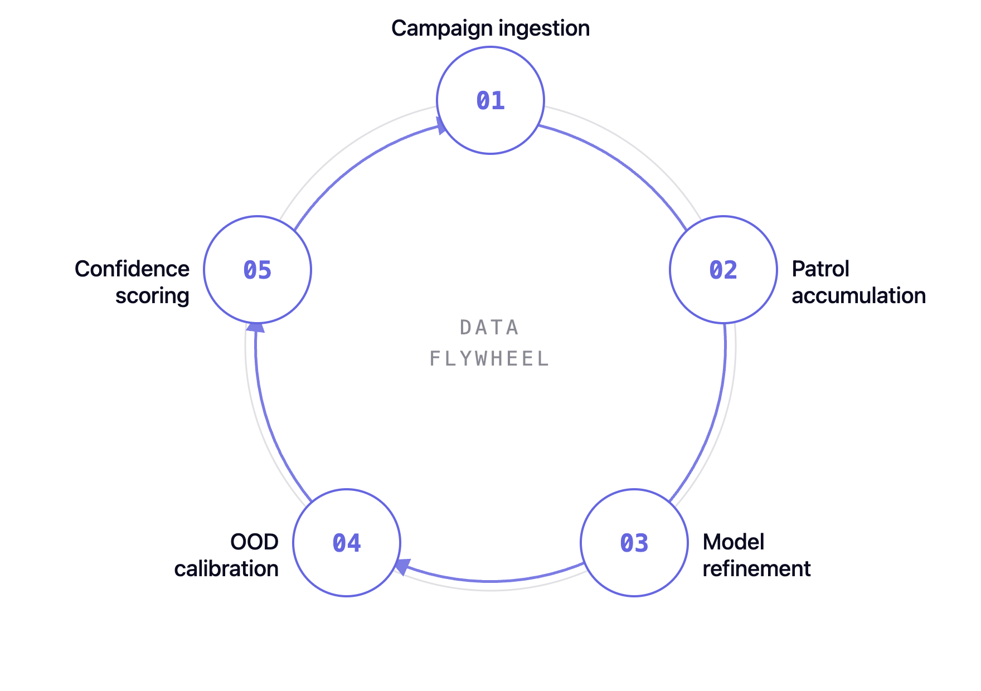
Kav AI Platform
14 / THE FLYWHEEL
COMPOUNDING ADVANTAGE
Every campaign compounds the moat.
Kav AI's advantage is not static. It widens with each inspection campaign, each patrol cycle, and each operator-confirmed finding — at each facility.
A customer 10 campaigns deep has a detection model tuned to their specific equipment, corrosion patterns, route coverage and operating conditions. A new entrant faces the same cold-start problem we've already solved.
HIGHER TIERS INCLUDE MORE CAMPAIGNS — INVESTMENT TIED TO MODEL PERFORMANCE.
15 / 17

Slide 16
Kav AI Platform
15 / PARTNERSHIP
→
Damage Mechanism Reviews (DMRs)
WITH OI.EXPERT
For asset classes covered by the pilot scope.
AI plus human engineering validation.
→
IOW recommendations & deviation response
Integrity Operating Window engineering support.
OI.Expert provides the corrosion and mechanical integrity expertise that ensures Kav AI's outputs are validated, acted upon, and embedded into the client's inspection programme.
→
HITL validation panel
Integrity Engineers confirm Stage 3.5 / 4 findings on Critical mechanisms (HIC, NH₄Cl, Creep).
→
Inspection programme integration
Embedding findings into RBI, IDMS & compliance (API 580 / 581 / 584 / 510 / 570).
×
OI.Expert
→
Fitness-for-Service & root cause
Reactive engineering, FFS, RCA, materials & welding consultation.
ALL OUTPUTS ARE RECOMMENDATIONS. THE CLIENT RETAINS FULL OPERATIONAL RESPONSIBILITY.
16 / 17

Slide 17
13 / NEXT STEP
LET'S TALK
Book a 90-day pilot.
Structured, time-boxed, with success criteria agreed before data ingestion begins. If we meet them, the pilot fee credits toward Year 1. If we don't, you walk — data deleted within 5 business days.
GET IN TOUCH
WEB
contactus@kavai.com
www.kavai.com
KAV AI TECHNOLOGIES INC. · NON-BINDING UNTIL MSA EXECUTION.
17 / 17

